Slide 1
Monitoria – Laboratorio
2022-2

Slide 2

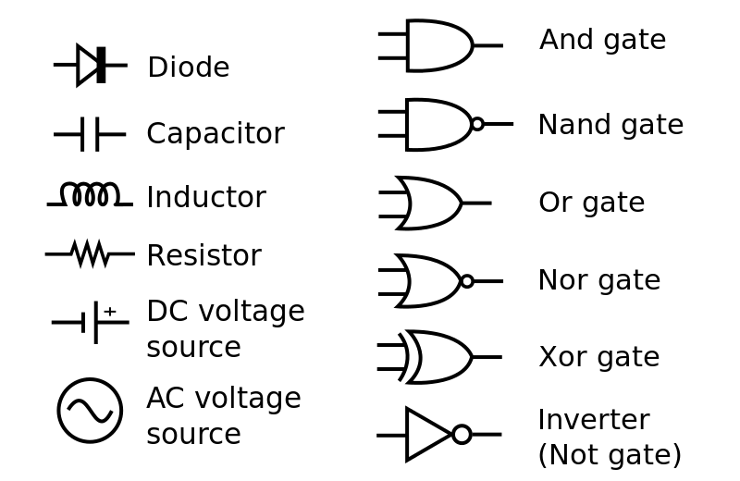
Simbologia principales componentes
https://www.youtube.com/watch?v=ZMVh1-L6f2w

Slide 3

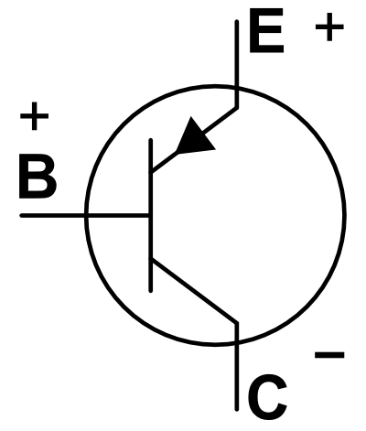
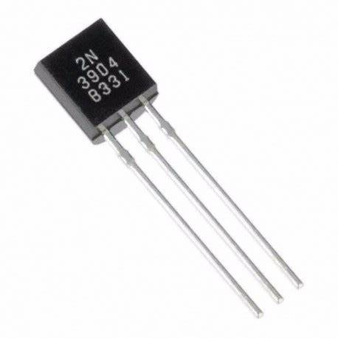
Transistor
https://www.youtube.com/watch?v=gHq9jB_pcl8 https://www.youtube.com/watch?v=dIV5l9cx_ck&list=PLuzS0jdNRVvpVTO-2va0jHcAyt5q8HV-O

Slide 4
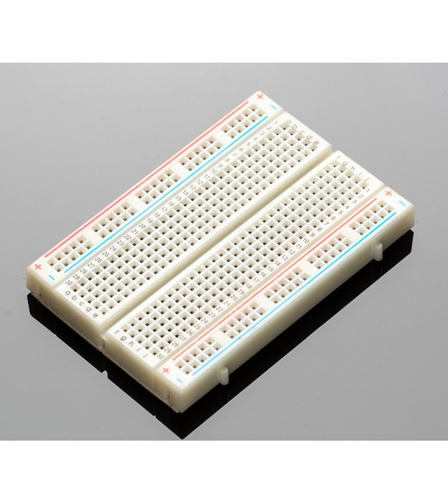
protoboard
https://www.google.com/search?q=protoboard+usage&rlz=1C1UEAD_esCO993CO993&oq=protoboard+usage&aqs=chrome..69i57.3405j0j7&sourceid=chrome&ie=UTF-8#kpvalbx=_OWjlYtj0ONqUwbkP8IylgAo16

Slide 5
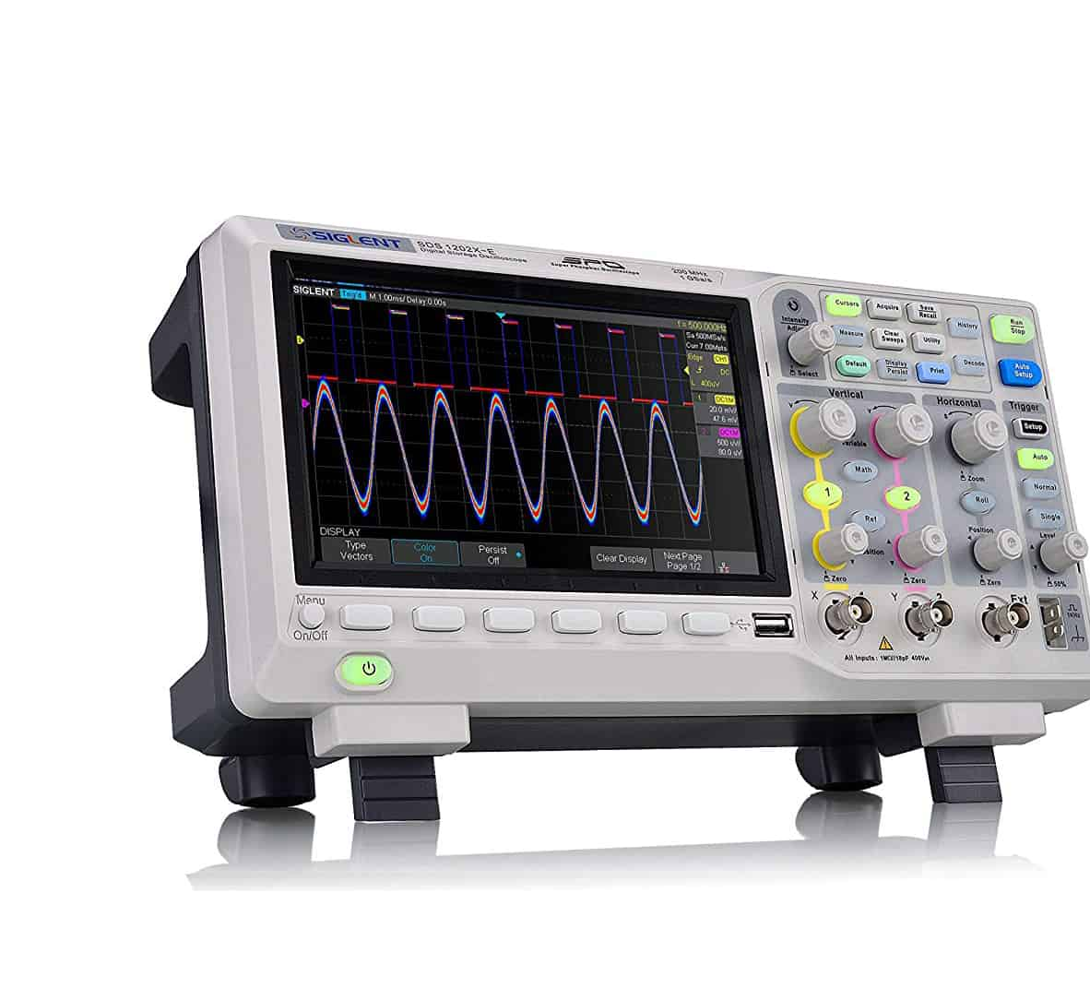
Osciloscopio

Slide 6
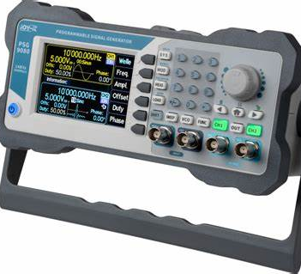
Generador de señales

Slide 7
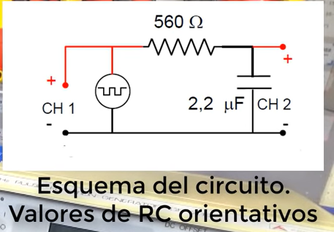
Circuitos
https://www.youtube.com/watch?v=pmSDwdrudi4
https://www.youtube.com/watch?v=ovVEZg92jGo

Slide 8
Laboratorio y pre laboratorio

